Slide 1
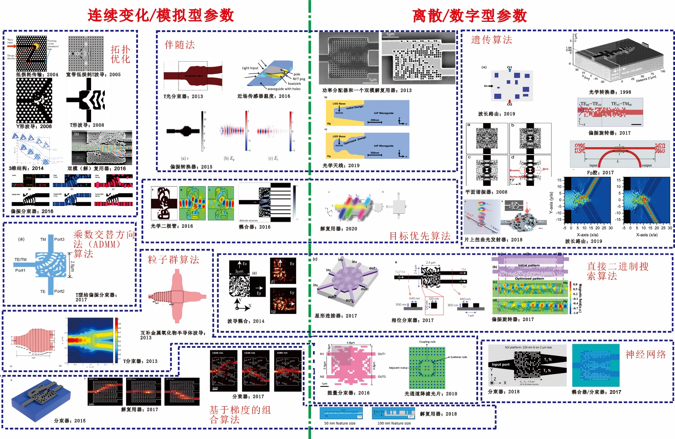

Slide 2

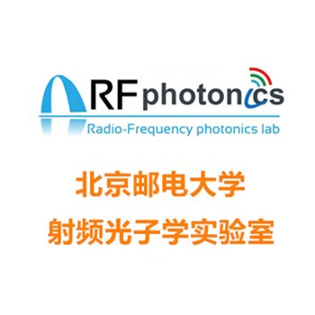
微纳光子器件的智能设计
报告人：于帅

Slide 3
高精度高精度刻蚀工艺
微纳光子器件的智能设计
计算资源
人工智能
设计对象
设计算法
设计目标

Slide 5
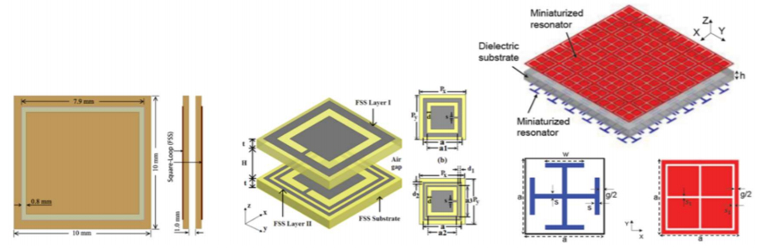
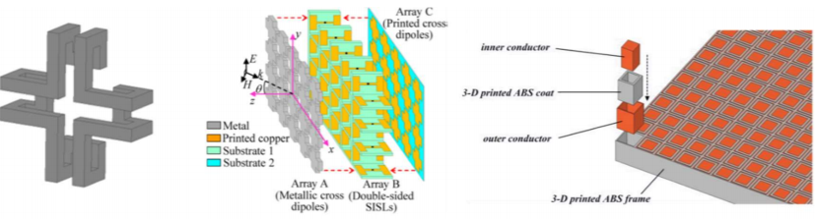
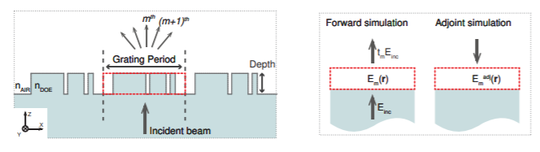
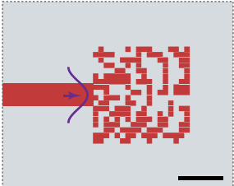
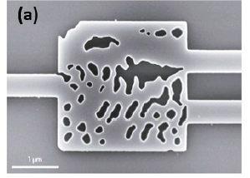
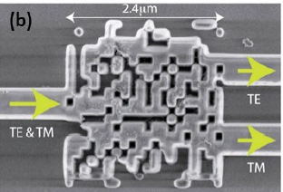
设计对象
亚波长结构：
（1）频率选择表面（Frequency selective surface, FSS）
（2）亚波长光栅（Sub-wavelength grating, SWG）
（3）超材料（Metamaterial，MM）
（4）自由形态亚波长结构（Free-form Subwavelength Structure）

Slide 6
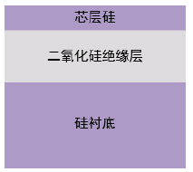
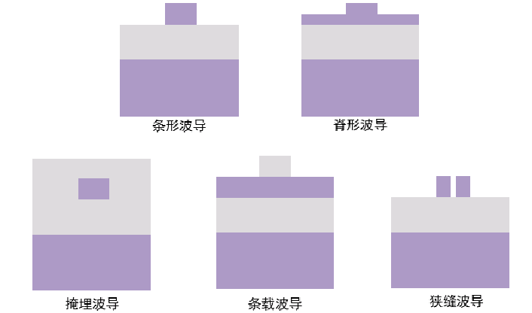
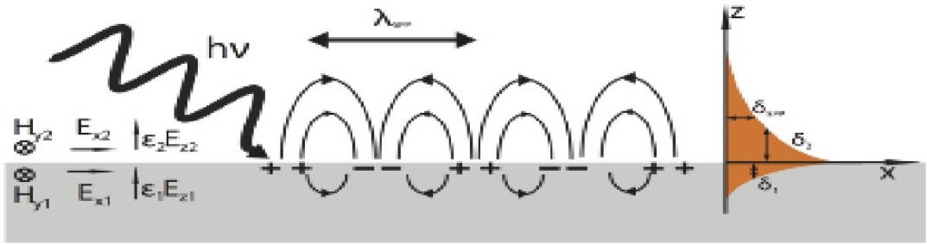
设计对象
材料：介质、金属？
SOI （Silicon on insulator）
金属超表面
SPP(surface plasmon polarization)

Slide 7
设计算法
基于适应度的演进类算法
遗传算法
GA
直接二进制搜索算法
DBS
粒子群算法
PSO

Slide 8
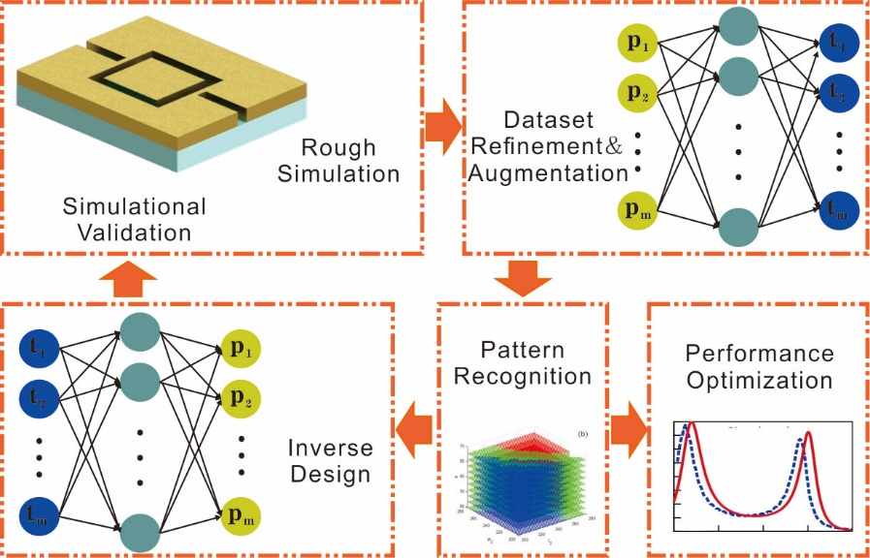
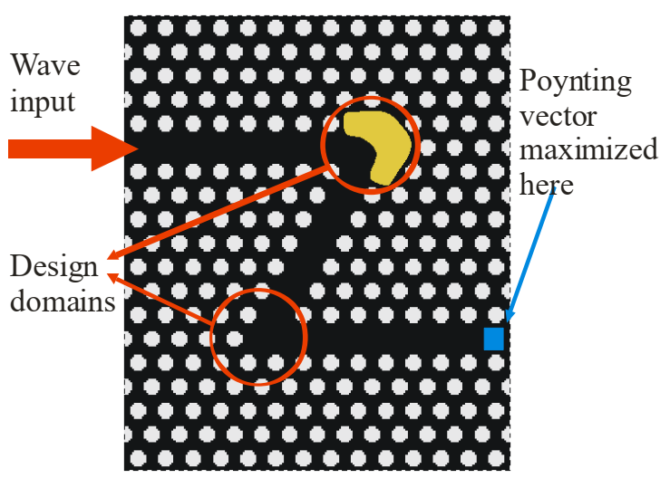
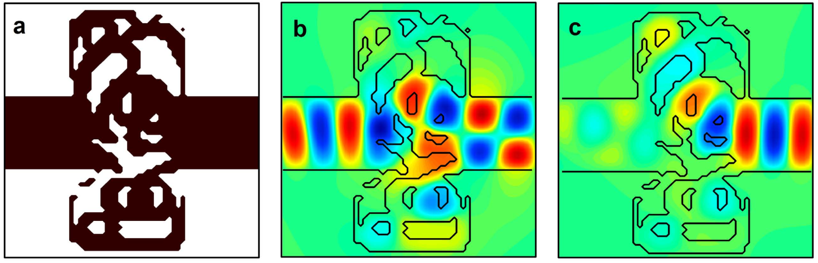
设计算法
建模算法
结构参数<->特征
拓扑优化算法
目标优先优化算法

Slide 9
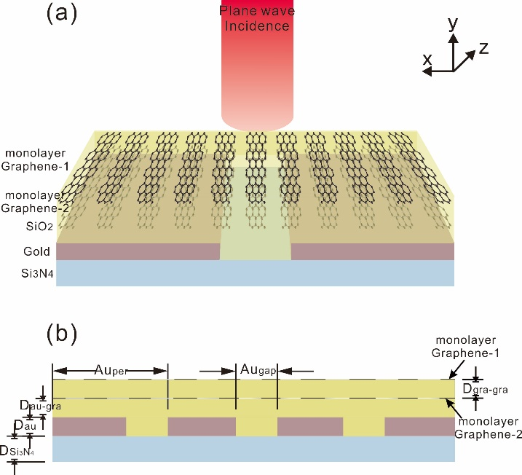
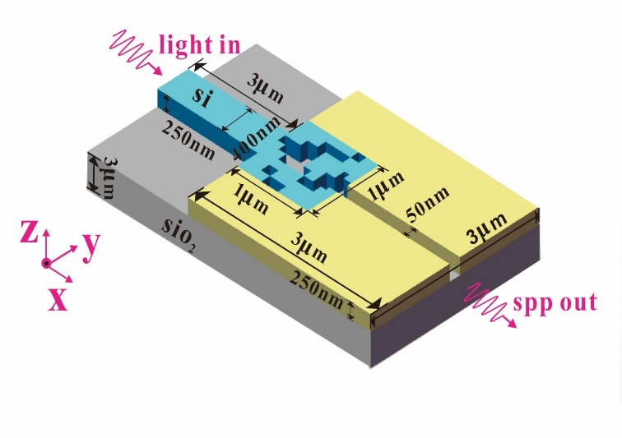
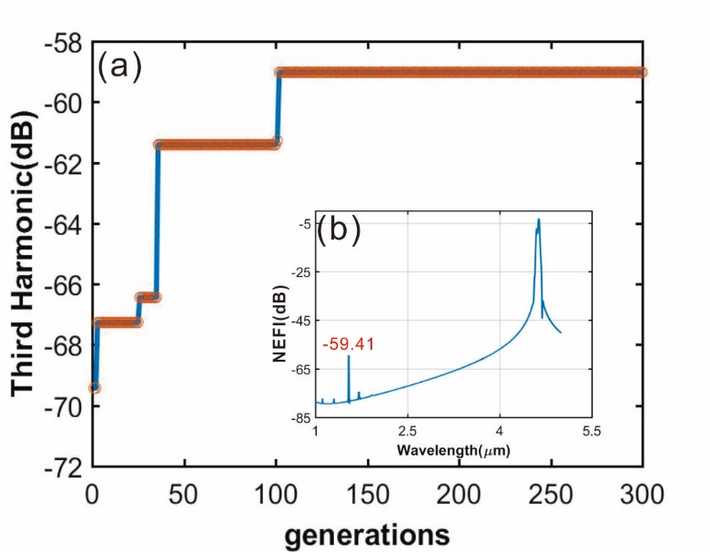
设计目标
针对具体参数的优化
例1：使用遗传算法
优化非线性转换效率
例2：使用多种梯度类算法
优化耦合效率
算法名称 | 最高透射率 | 最低透射率
GA | 75.1% | 55.6%
BPSO | 70.6% | 50.7%
SA | 78% | 69%
MDBS | 94.7% | 93%

Slide 10
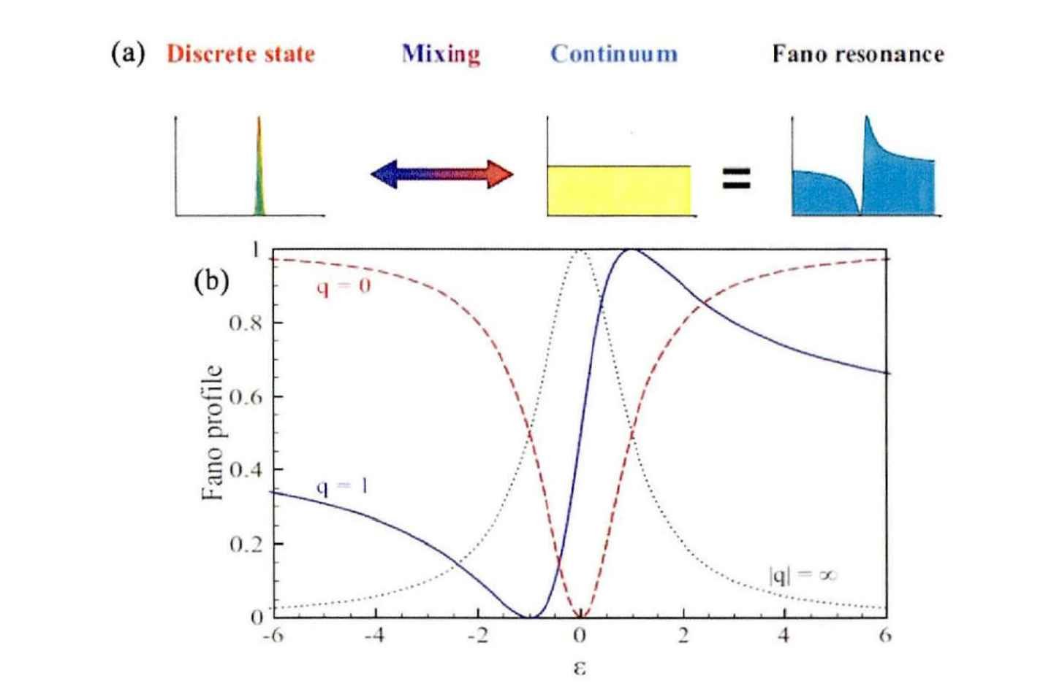
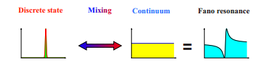
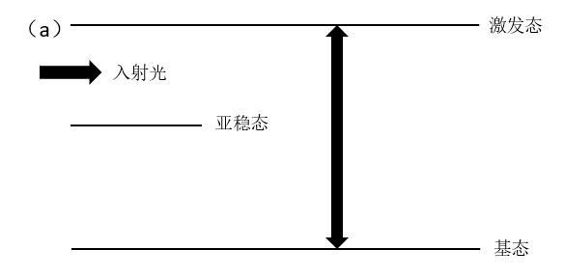
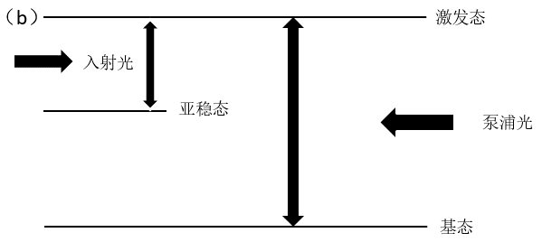
设计目标
针对特定性质的优化
Fano谐振
电磁诱导透明 (EIT)

Slide 11
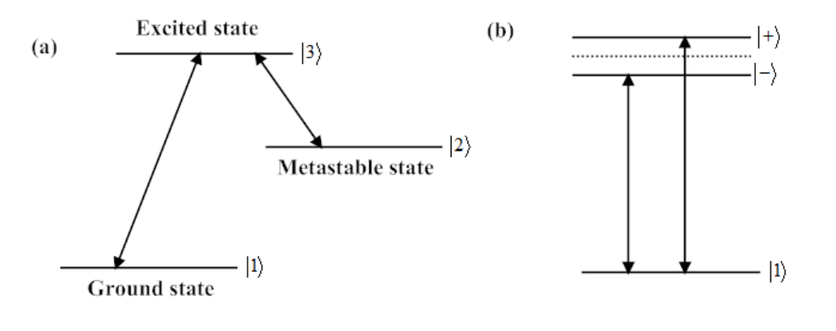
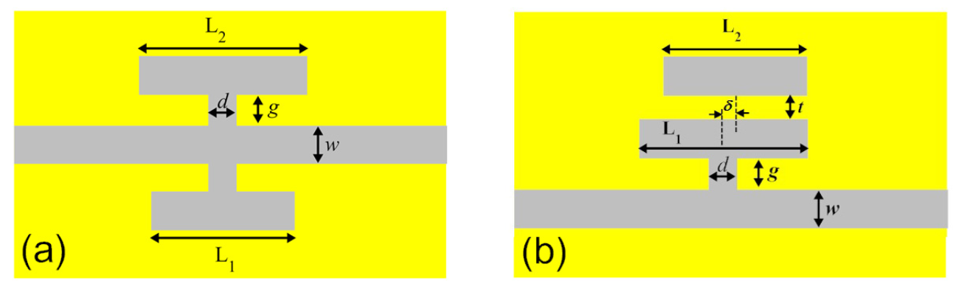
设计目标
电磁诱导透明 (EIT)的类似物

Slide 12
References：
Yang Y, Wang W, Boulesbaa A, et al. Nonlinear Fano-resonant dielectric metasurfaces[J]. Nano letters, 2015, 15(11): 7388-7393.
Tong W, Gong C, Liu X, et al. Enhanced third harmonic generation in a silicon metasurface using trapped mode[J]. Optics express, 2016, 24(17): 19661-19670.
P. I. Borel, A. Harpøth, L. H. Frandsen, et al. Topology optimization and fabrication of photonic crystal structures. Optics Express, 2004, 12(9): 1996~2001
J. S. Jensen, O. Sigmund. Systematic design of photonic crystal structures using topology optimization: Low-loss waveguide bends. Applied Physics Letters, 2004, 84(12): 2022~2024
J. S. Jensen, O. Sigmund. Topology optimization of photonic crystal structures: a high-bandwidth low-loss T-junction waveguide. Journal of the Optical Society of America B, 2005, 22(6): 1191~1198
P. I. Borel, B. Bilenberg, L. H. Frandsen, et al. Imprinted silicon-based nanophotonics. Optics Express, 2007, 15(3): 1261~1266
Y. Tsuji, K. Hirayama. Design of optical circuit devices using topology optimization method with function-expansion based refractive index distribution. IEEE Photonics Technology Letters, 2008, 20(12): 982~984
H. Men, K. Y. K. Lee, R. M. Freund, et al. Robust topology optimization of three-dimensional photonic-crystal band-gap structures. Optics Express, 2014, 22(19): 22632~22648
L. F. Frellsen, Y. Ding, O. Sigmund, et al. Topology optimized mode multiplexing in silicon-on-insulator photonic wire waveguides. Optics Express, 2016, 24(15): 16866~16873
L. F. Frellsen, O. Sigmund. Inverse design engineering of all-silicon polarization beam splitters. Proceedings of SPIE, 2016, 9756: 97560Y
O. D. Miller. Photonic design: from fundamental solar cell physics to computational inverse design: [Ph.D paper]. Berkeley: University of California, 2012
C. M. Lalau-Keraly, S. Bhargava, O. D. Miller, et al. Adjoint shape optimization applied to electromagnetic design. Optics Express, 2013, 21(18): 21693~21701
V. Ganapati, O. D. Miller, E. Yablonovitch. Light trapping textures designed by electromagnetic optimization for subwavelength thick solar cells. IEEE Journal of Photovoltaics, 2014, 4(1): 175~182
S. Bhargava, E. Yablonovitch. Lowering HAMR near-field transducer temperature via inverse electromagnetic design. IEEE Transactions on Magnetics, 2015, 51(4): 3100407
T. P. Xiao, O. S. Cifci, S. Bhargava, et al. Diffractive spectral-splitting optical element designed by adjoint-based electromagnetic optimization and fabricated by femtosecond 3D direct laser writing. ACS Photonics, 2016, 3: 886~894
......

Slide 13
Thanks for listening

